Slide 1
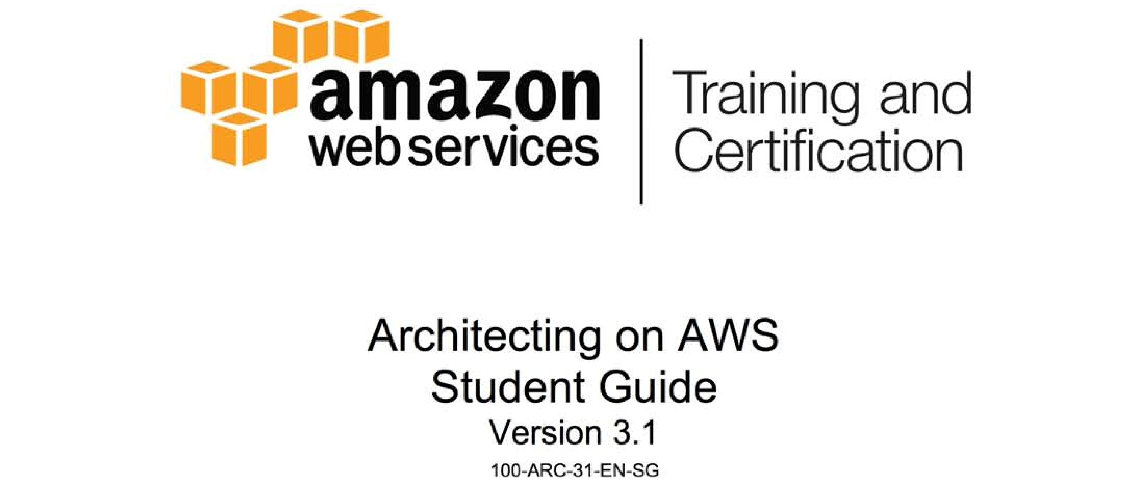

Slide 2

Module 12: Designing for Cost

Slide 3
Topics
Cost model
Services and feature costs
Billing options
Best practices

Slide 4
Topics
Cost model
Services and feature costs
Billing options
Best practices

Slide 5
Cost model
Amazon wants customers to pay for exactly what they use
Do not pay for unutilized feature or services
This model translates into a very granular cost structure
Every Application has different component bounding (CPU, Memory, Disk I/O), pay for what you use
Customers have control of how they utilize our products and service, which leads to control over cost expenditures

Slide 6
Topics
Cost model
Services and feature costs
Billing options
Best practices

Slide 7
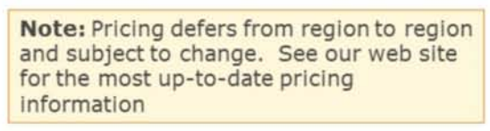
ELB, EIP, and CloudWatch Costs
EIP
Free when associated with an EC2 instance
$0.005 per hour unassociated
$0.10 per 100 remaps
CloudWatch
Detailed monitoring $3.50 per instance per month
Custom metrics $0.50 per metric per month
ELB
$0.025 per ELB-hour
$0.008 per GB of bandwidth

Slide 8
ESB Service and Feature Costs
Standard EBS Volume
$0.05 per GB/month
$0.05 per million I/O requests
Provisioned IOPS EBS Volumes
$0.125 per GB-month of provisioned storage
$0.10 per Provisioned IOPS-month
EBS Snapshots to Amazon S3
$0.095 per GB-month of data stored

Slide 9
S3, S3 RRS, Glacier Costs
Pay for capacity used. For the first 1TB per month:
S3 Standard Storage - $0.03/GB
S3 Reduced Redundancy Storage - $0.024/GB
Glacier - $0.01/GB
S3 PUT, COPY, POST, LIST - $0.05 per 1,000 requests
Glacier Archive/Restore - $0.05 per 1,000 requests
DELETE – Free
GET and all other requests - $0.004 per 10,000 requests
Data transfer OUT from S3 to Internet - $0.12 per GB up to 10TB per month

Slide 10
RDS Service and Feature Costs
Multiple instance types to choose from
Provisioned IOPS (up to 30,000 per DB) optional
Data Transfer Out of a Region - $0.02/GB
Reserved billing model available

Slide 11
DynamoDB Service Costs
Provision IOPS capacity
$0.0065 per hour for every 10 units of write capacity
$0.0065 per hour for every 50 units of read capacity
Indexed data storage
First 100MB stored per month is free
$0.25 per GB-month thereafter
Data transfer OUT - $0.12/GB up to 10TB/month
Reserved billing model available

Slide 12
R53 and CloudFront Service Costs
Route 53
$0.50 per hosted zone/month for the first 25 hosted zones
$0.50 per million queries for the first 1 billion queries/month
$0.75 per million for latency based queries for the first 1 billion queries/month
$0.50 per health check per month inside AWS, $0.75 outside (S3 Endpoints are free) – Basic Health Check
CloudFront
Bandwidth out $0.12 per GB (US and Europe) for the first 10TB/month
$0.0075 per 10,000 requests (US) for all HTTP methods
Pricing based on edge location. For details see: http://aws/amazon.com/cloudfront/pricing

Slide 13
SQS, SNS, SES Service and Feature Costs
SQS
First 1 million SQS requests/month are free. $0.05 per 1 million SQS requests/month thereafter
SNS
$0.06 per million HTTP/s notifications
$2.00 per 100,000 Emails notifications
$0.75 per 100 SMS notifications
No charge for SQS notifications
SES
$0.10 per 1,000 Emails out
Data transfer inside a region is free
$0.12 per GB of attachments sent

Slide 14
Topics
Cost model
Services and feature costs
Billing options
Best practices

Slide 15
Free Services and Features
Free Tier Utilization
VPC
Auto Scaling
Cloud Watch standard metrics
CloudFormation
IAM
OpsWorks
Elastic Beanstalk

Slide 16
EC2 Billing Options
Prices vary by instance type – optimized to fit different use cases
On Demand prices should be considered retail rate
Reserved Instance billing model available
Unique Spot Marker available

Slide 17
Your choice of Amazon EC2 instances matters
A larger compute instance will sometimes save you not only time but money too. Paying more per hour for a shorter amount of time can be less expensive
Instances come in multiple sizes, allowing you to optimally scale resources to the requirements of your workload. As you choose an instance type, consider the following:
Core count
Memory size
Storage size & type
Network performance

Slide 18
Additional Features that impact your workload
Intel AES-NI1 – Intel processors that support these new encryption instructions allow you to enable encryption for enhanced data security without paying a performance penalty
Intel AVX – Get dramatically better performance for parallel HPC workloads such as life science engineering, data mining, financial analysis, or other technical computing applications. AVX also enhances image, video, and audio processing.
Intel Turbo Boost Technology2 – Get a turbo boost of compute speed, accelerating performance for peak loads. This Instance is appropriate for traditional non-parallel workloads.

Slide 19
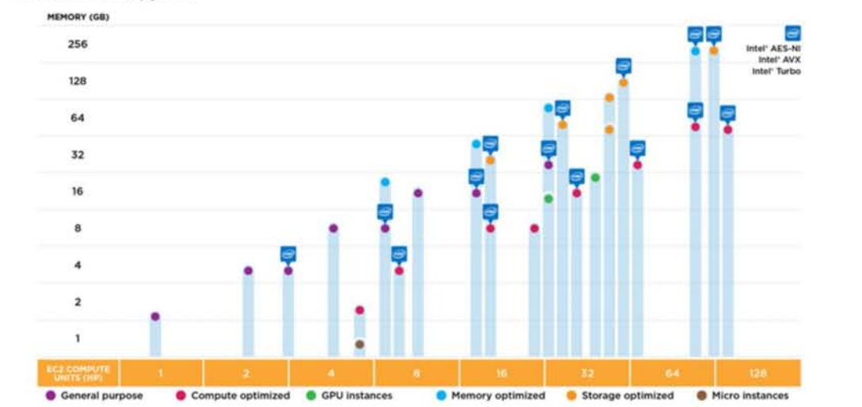
Instances with All Three Intel® Xeon® Processor Technologies

Slide 20
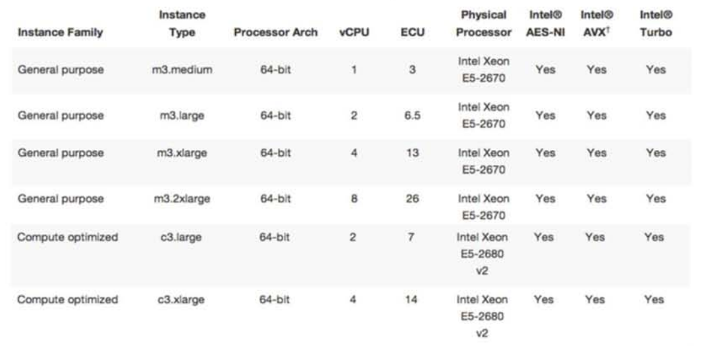
Amazon EC2 Intel Processor Specifications

Slide 21
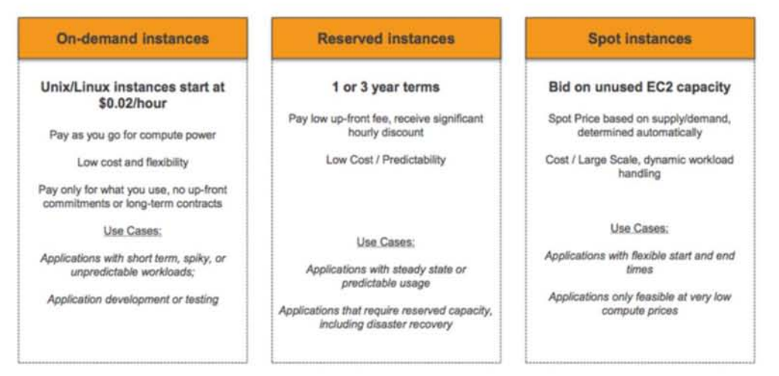
EC2 Billing Options

Slide 22
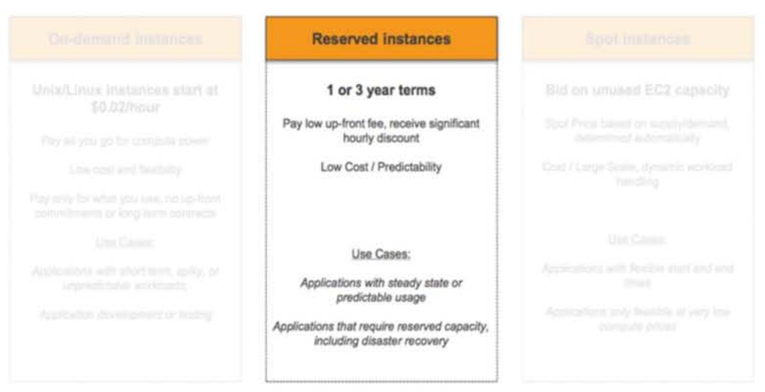
EC2 Billing Options

Slide 23
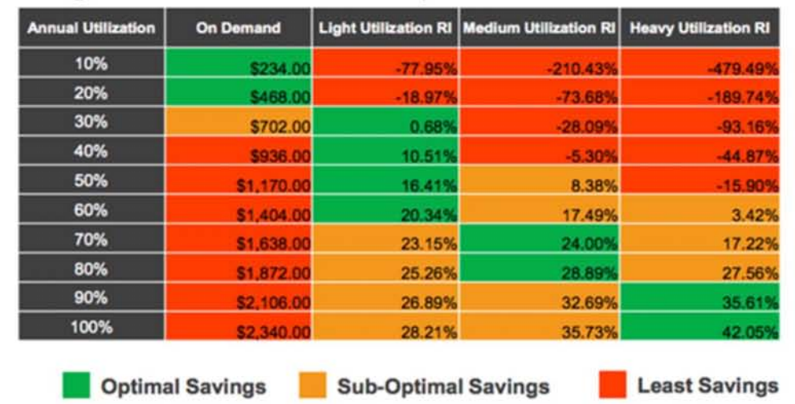
Reserved Instance Cost Savings Over On-Demand (m1.large – Linux – One Year RI)

Slide 24
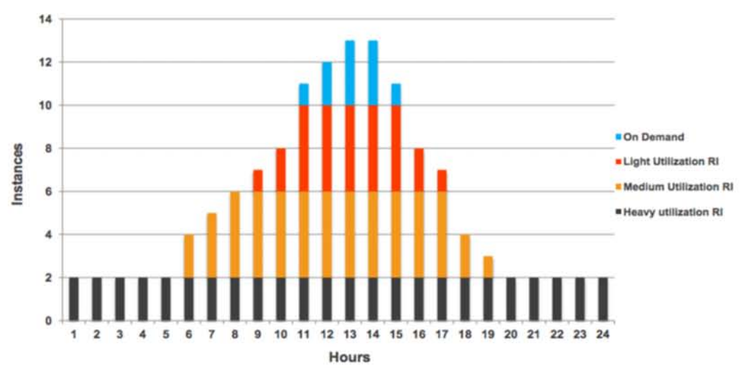
Reserved Instances

Slide 25
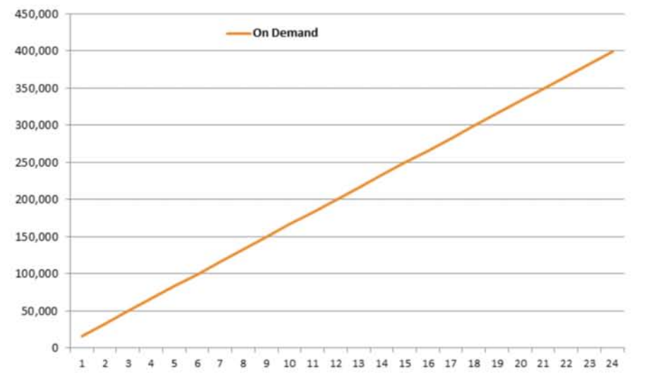
Reserved vs. On-Demand

Slide 26
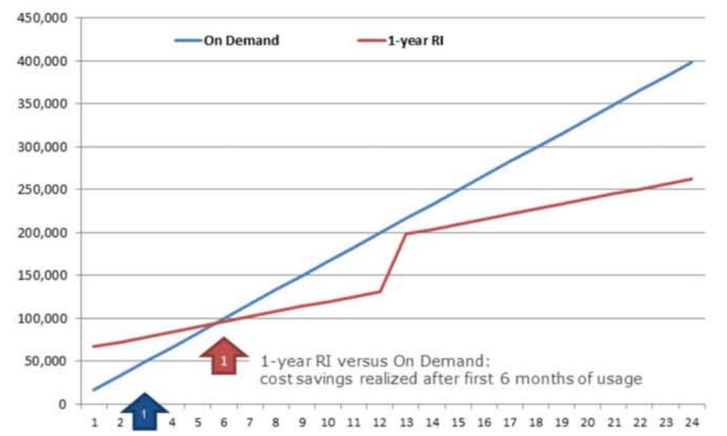
Reserved vs. On-Demand

Slide 27
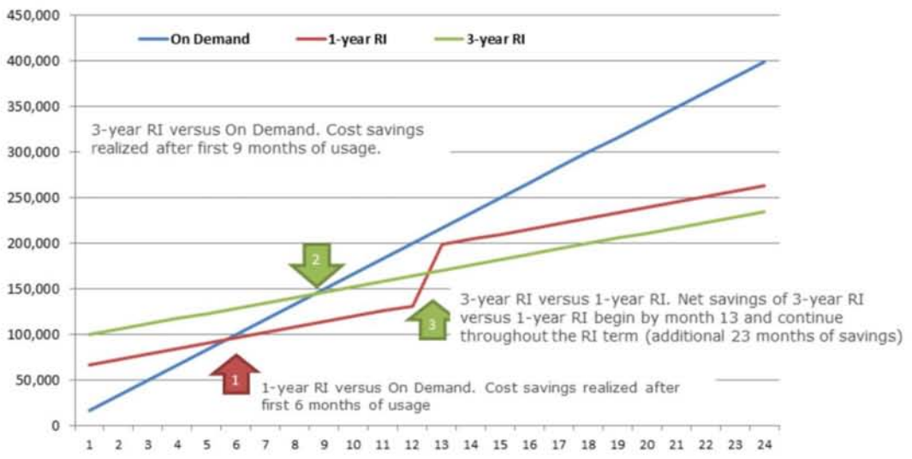
Reserved vs. On-Demand

Slide 28
Spot Market
Spot instances often offer a significant savings over on-demand
After an architecture is built for elasticity, leveraging spot instances can be a simple change

Slide 29
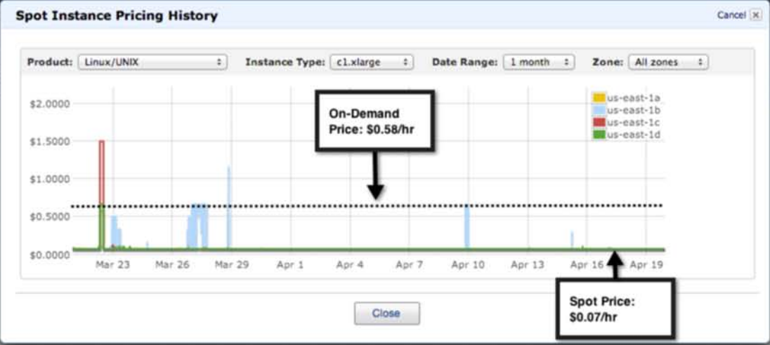
Spot Market

Slide 30
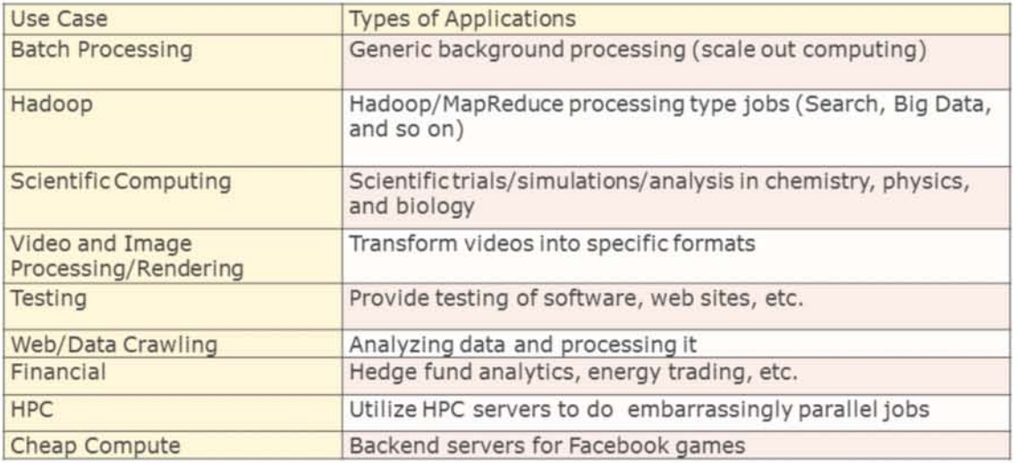
Spot Market

Slide 31
Spot Market
Best practices for using spot instances:
Save your work frequently
Add checkpoints
Split up your work
Test your application
Use spot and on-demand in hybrid fashion → Master node in cluster is on-demand instance, worker nodes are Spot Instances

Slide 32
Topics
Cost model
Services and feature costs
Billing options
Best practices

Slide 33
Minimize Always On instances
Elasticity is one of the fundamental properties of the cloud that drives many of its economic benefits
Optimize your usage based on real-time demand
Reduce the number of web servers during off-peak periods
Shut down processing nodes unused at night
Purchase Reserved Instances for the Always On fleet

Slide 34
Scale-in automatically
Scaling out is key to serving customer needs but scaling in is where the savings occur
Auto-scaling works well for stateless components
Scripted scaling makes sense for stateful components
Examples
Auto-scaling based on Network I/O for web servers
De-scaling RDS instances on the weekend
Shutting down all workers when batch processing queues are empty

Slide 35
Scripted scaling
Some scenarios do not lend themselves to automated de-scaling due to complex application logic
Shutting down worker nodes only when they are not currently working
Shutting down RDS read replicas during weekends
Every AWS service has an API and command line tools for managing it
Scripting of scaling activities can be a significant cost savings for little effort

Slide 36
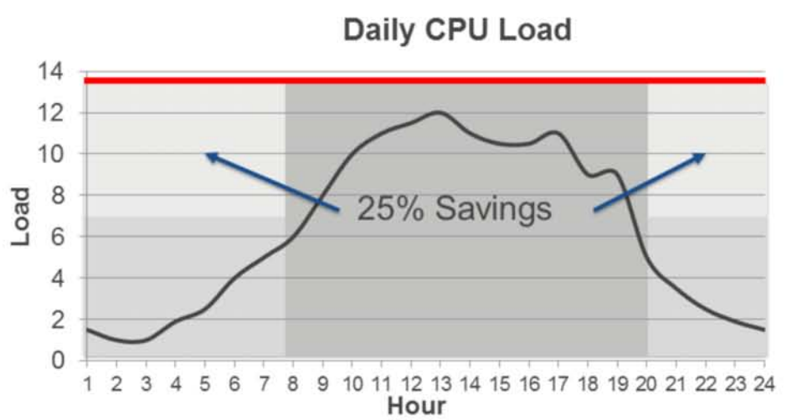
Optimize by time of day

Slide 37
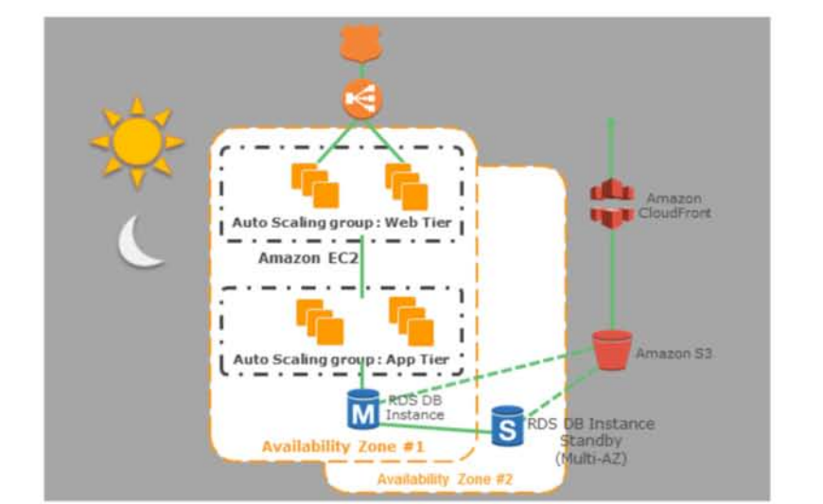
Optimize by time of day

Slide 38
End of month processing
Expand the cluster at the end of the month
Expand/Shrink feature in Amazon Elastic MapReduce
Vertically Scale up at the end of the month
Modify-DB-Instance (in Amazon RDS) (or a New RDS DB Instance)
CloudFormation Script (in Amazon EC2)

Slide 39
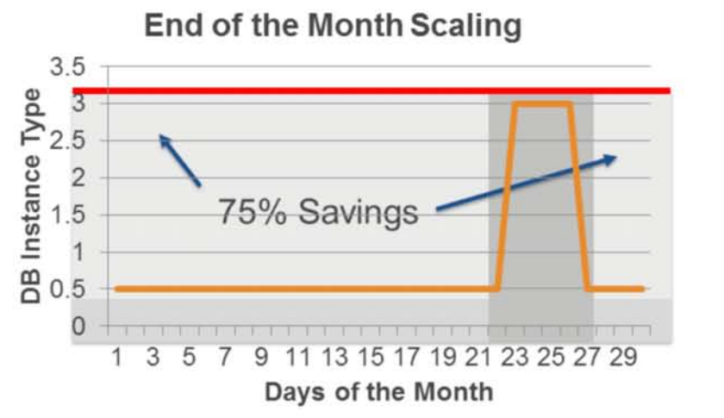
Optimize during the month

Slide 40
Leverage scalable, on-demand services
EC2 can run almost anything but there are many cases where it is not cost effective
AWS offers many scalable and cost-effective options for common application needs:
ELB instead of a software load balancer on EC2
SQS instead of a queue on EC2

Slide 41
Best Practices
Software LB on EC2
Pros
Application-tier load balancer
Cons
SPOF
Elasticity has to be implemented manually
Not as cost-effective
ELB
Pros
Pay as you go
Scalability
Availability
High performance

Slide 42
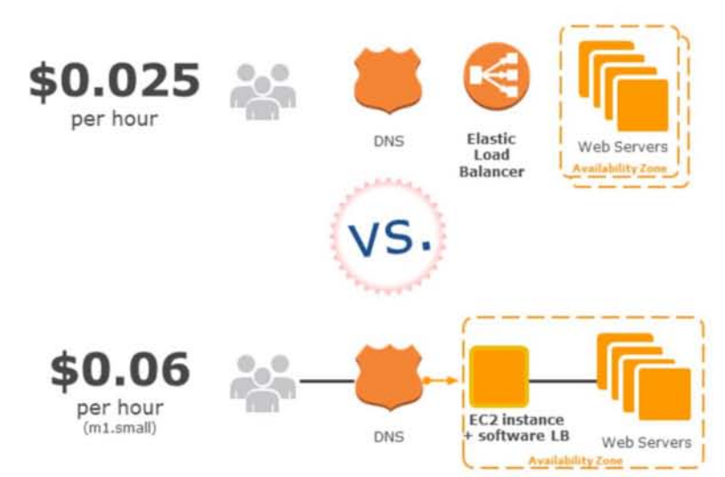
Best Practices (continue)

Slide 43
Best Practices
Software on EC2
Pros
Custom features
Cons
Requires an instance
SPOF
Limited to one AZ
DIY administration
SNS, SQS, SES
Pros
Elastic and Fault-tolerant
Auto scaling
Monitoring included
IPV6
Cons
Internal load balancing only in VPC

Slide 44
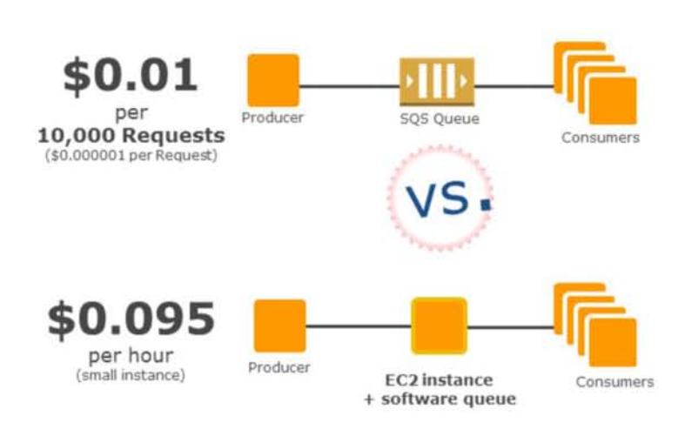
Best Practices

Slide 45
Clean up after yourself
When it is easy to create resources, it can be easy to forget about them
Use tagging to identify the purpose of resources
Use CloudWatch to identify underutilized resources
Keep track of objects in S3 and clean up unused content
Release unused Elastic IPs
Examples
Daily report on utilization of resources
Clean up script to delete old S3 objects
Make use of Trusted Advisor

Slide 46
Economics Center
http://aws.amazon.com/economics

